Slide 1

Fake News Detection Using Artificial Intelligence
Author : Ashok Jana

Slide 2
Introduction
Due to Rapid growth of digital media information is spreading quickly
Along with that fake news is also spreading Fastly
Effects
People’s opinions
Elections
Economy and society
Goal is to Develop a system which can Detect fake news automatically
In my project I Used ML models and BERT model to classify news as real or fake

Slide 3
Problem Statement
Huge amount of information is generating daily . It is very hard to manually verify every news article, and more over manual checking is slow and not scalable. So, detecting fake news accurately is still a challenge .

Slide 4
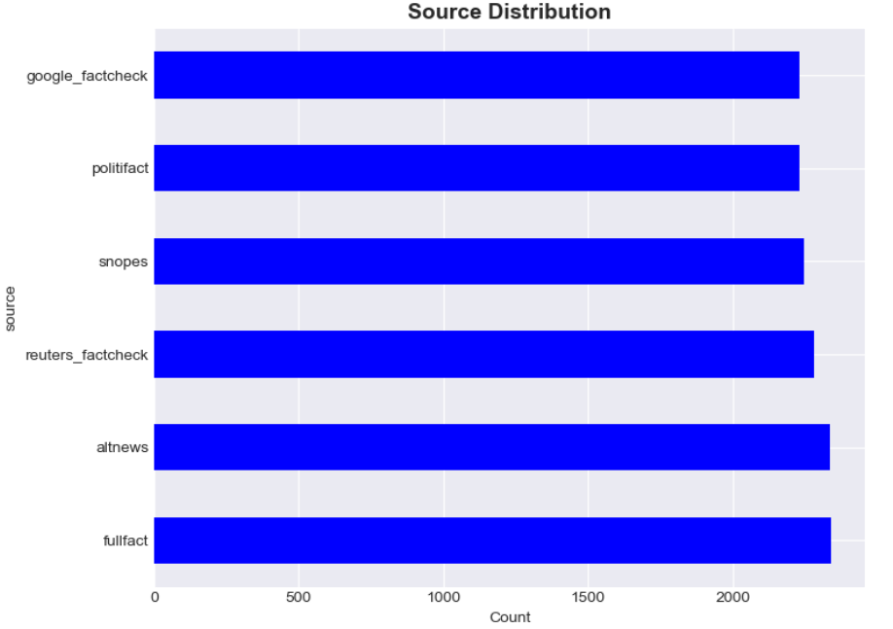
Data Collection
Data collected from Web scraping and Google fact check Api
Web Scraping
Politifact - 2231
Snopes - 2247
reuters_factcheck - 2283
Fullfact - 2340
Altnews - 2337
Google Fact check API - 2230
Dataset has four columns: Text , Label , Confidence , Source

Slide 5
Data Cleaning
Performed Text Normalization
Removed unwanted characters
Removed URL , numbers and extra spaces
Removed short text and duplicated records

Slide 6
Feature Engineering
I used TF-IDF features to convert text into numerical form
Word count to find number of words in text
Average word length used to measure writing style
Capital ratio to find the text which is written in dramatic way
Punctuation count used to detect emotional writing
BERT embeddings used to understand the meaning of words

Slide 7
ML Models Hyperparameters
Logistic Regression - max_iter=1000 , random_state = 42
Naïve Bayes - alpha=3.0
SVM - C=0.015, random_state=42
Random Forest - n_estimators=30, max_depth=4, min_samples_leaf=20, random_state=42
Gradient Boosting - n_estimators=25, learning_rate=0.03, max_depth=1, random_state=42
XGBoost - n_estimators=25, max_depth=1, learning_rate=0.03, subsample=0.75,
colsample_bytree=0.75, reg_lambda=12.0, random_state=42

Slide 8
Machine Learning Models and Results
Accuracy Precision Recall F1-Score
Logistic Regression 0.7462 0.7601 0.7146 0.7366
Naive Bayes 0.6489 0.7242 0.4735 0.5726
SVM 0.7462 0.7642 0.7073 0.7346
Random Forest 0.7462 0.7513 0.7310 0.7410
Gradient Boosting 0.6818 0.6451 0.7990 0.7138
XGBoost 0.6808 0.6449 0.7951 0.7122

Slide 9
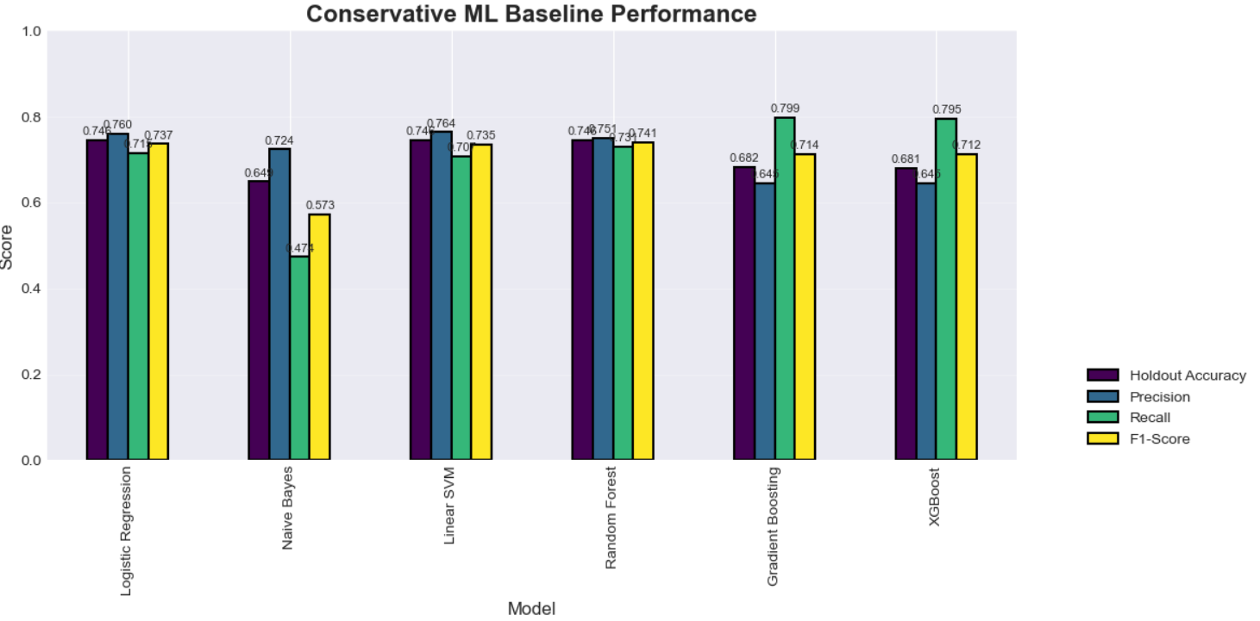
ML Models Comparison
Among all ML Models Random Forest model preforms well with high accuracy 0.7468 and F1-score 0.7410

Slide 10
BERT Model
I Used DistilBERT pre-trained model for text classification in my project
Tokenized text using BERT tokenizer and Trained the model using hugging face
Fine –tuned the DistilBert model on the dataset
DistilBert Hyperparameters - learning_rate = 2e-5 ,per_device_train_batch_size = 16
per_device_eval_batch_size = 16 ,num_train_epochs = 3
weight_decay = 0.01 , logging_steps = 100
Saved the model and tested it on some custom text

Slide 11
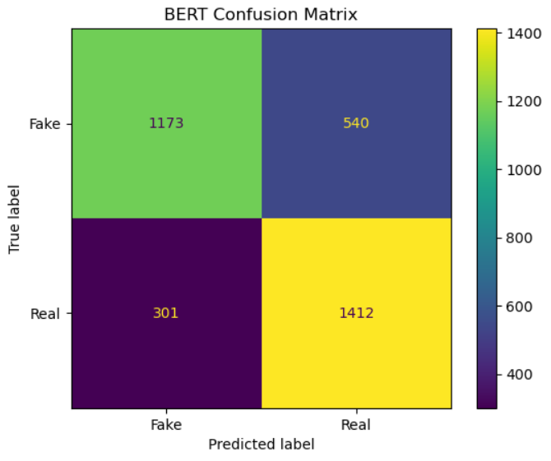
BERT Model Results
Accuracy - 0.7569
Precision - 0.7277
Recall - 0.8208
F1-score - 0.7715

Slide 12
Conclusion
Able to develop both ML models and DistilBert
Among all ML Models Random Forest performed well with high F1 – Score 0.7410 and accuracy of 0.7468
DistilBERT able to performs well on unseen data with an accuracy of 76 %

Slide 13
Thank You

